Slide 1
Microsoft Dynamics AX 2012 Administration Workshop Chapter 14: Services
Presenter Name
Presenter Title
Presenter Company

Slide 2
Conditions and Terms of Use
Microsoft Confidential
This training package is proprietary and confidential, and is intended only for uses described in the training materials. Content and software is provided to you under a Non-Disclosure Agreement and cannot be distributed. Copying or disclosing all or any portion of the content and/or software included in such packages is strictly prohibited.
The contents of this package are for informational and training purposes only and are provided "as is" without warranty of any kind, whether express or implied, including but not limited to the implied warranties of merchantability, fitness for a particular purpose, and non-infringement.
Training package content, including URLs and other Internet Web site references, is subject to change without notice. Because Microsoft must respond to changing market conditions, the content should not be interpreted to be a commitment on the part of Microsoft, and Microsoft cannot guarantee the accuracy of any information presented after the date of publication. Unless otherwise noted, the companies, organizations, products, domain names, e-mail addresses, logos, people, places, and events depicted herein are fictitious, and no association with any real company, organization, product, domain name, e-mail address, logo, person, place, or event is intended or should be inferred.
Copyright and Trademarks
© 2013 Microsoft Corporation. All rights reserved.
Microsoft may have patents, patent applications, trademarks, copyrights, or other intellectual property rights covering subject matter in this document. Except as expressly provided in written license agreement from Microsoft, the furnishing of this document does not give you any license to these patents, trademarks, copyrights, or other intellectual property.
Complying with all applicable copyright laws is the responsibility of the user. Without limiting the rights under copyright, no part of this document may be reproduced, stored in or introduced into a retrieval system, or transmitted in any form or by any means (electronic, mechanical, photocopying, recording, or otherwise), or for any purpose, without the express written permission of Microsoft Corporation.
For more information, see Use of Microsoft Copyrighted Content at http://www.microsoft.com/about/legal/permissions/
Microsoft®, Internet Explorer®, Outlook®, SkyDrive®, Windows Vista®, Zune®, Xbox 360®, DirectX®, Windows Server®, Windows® and Microsoft Dynamics® are either registered trademarks or trademarks of Microsoft Corporation in the United States and/or other countries. Other Microsoft products mentioned herein may be either registered trademarks or trademarks of Microsoft Corporation in the United States and/or other countries. All other trademarks are property of their respective owners.

Slide 3
Students: How to View this Presentation
Switch to Notes Page view
Click View on the ribbon and select Notes Page
Use page up or page down to navigate
Zoom in or out as needed
Most slides will have supporting text that you can view now or after the delivery
Add notes to your copy of the presentation if you want to
You take the presentation files home with you

Slide 4
Overview
Overview
This chapter reviews the installation and deployment of services.
Steps required for configuring inbound and outbound ports will also be covered.
In addition, the following topics and features will be reviewed:
Simplified user interface
Services and AIF adapters
Services hosted on the Application Object Server (AOS)
IIS service hosting without .NET Business Connector
Service Groups
Support for non-XML files
Performance improvements in services and AIF

Slide 5
Objectives
Review how documents are exchanged with the Application Integration Framework and discuss the system services
Explain how to set up and administer services
Describe the integration features and how to plan for the integration
Review tools for troubleshooting and monitoring services
Explain services security

Slide 6
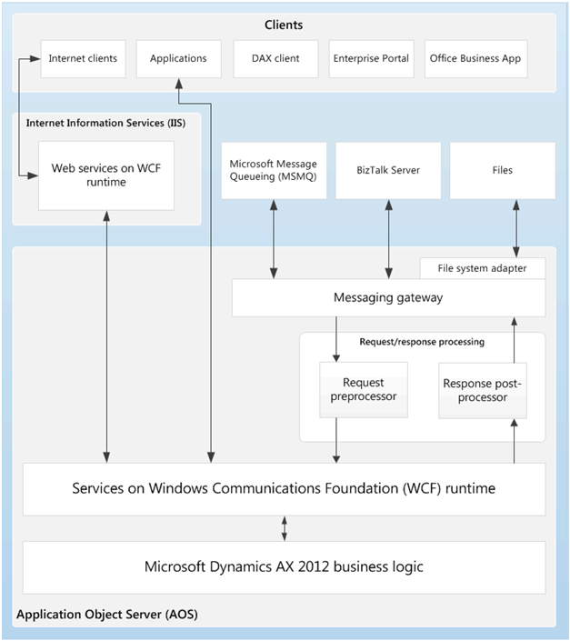
Services Overview
Notes:
The AOS is the Windows Communication Foundation (WCF) service host for Microsoft Dynamics AX 2012 services exposed to users and applications on an intranet.
To consume services over the Internet, you must host services on Internet Information Services (IIS). IIS-hosted services use the WCF message routing service. Microsoft Dynamics AX deploys the Web Services Description Language (WSDL)-based service in a subfolder in the virtual directory that is associated with the web site you provide.
IIS routes all service requests (those originating on the Internet or the intranet) to the AOS. Then the AOS returns a response to the service consumer through IIS. Exchanges configured to use web services are processed synchronously and do not use the Microsoft Dynamics AX queues.
Note: System services cannot be customized and they are not mapped to any query or X++ code.

Slide 7
Types of Services
Document services: Introduced in Microsoft Dynamics AX 4.0. They are query-based services, and exchange data with external systems by sending and receiving XML documents. These documents represent business entities, such as customers, vendors, or sales orders
Custom services: Used by developers to expose any X++ logic, such as X++ classes and their members, through a service interface
System services: Provided by Microsoft Dynamics AX. System services include the Query service, the Metadata service, and the User Session service
Notes:
Types of Services
Microsoft Dynamics AX 2012 supports the following three kinds of services:
Document services: Introduced in Microsoft Dynamics AX 4.0. They are query-based services, and exchange data with external systems by sending and receiving XML documents. These documents represent business entities, such as customers, vendors, or sales orders
Custom services: Used by developers to expose any X++ logic, such as X++ classes and their members, through a service interface
System services: Provided by Microsoft Dynamics AX. System services include the Query service, the Metadata service, and the User Session service

Slide 8
Methods to Integrate
You can use the following methods to integrate Microsoft Dynamics AX 2012 with other applications:
.NET interop to X++:
You can use the .NET interop to X++ feature to call X++ code using C# or another managed language
.NET interop from X++:
The .NET interop from X++ (also known as the CLR Interop in the previous release) provides interoperability with external .NET components and you can execute managed-code components from within X++ code
Consume external web services:
You can use the Microsoft Dynamics AX programming model to consume external web services from within X++ code
Notes:
Application Integration
Companies can use Microsoft Dynamics AX Application Integration Framework (AIF) to integrate and communicate with external business processes and partners through the exchange of XML over various transport media.
In addition to the AIF, Microsoft Dynamics AX includes several system services that include a Metadata service and a Query Service. System services are WCF services that are included with Microsoft Dynamics AX; clients can use these services to interact with and retrieve system information.
You can use the following methods to integrate Microsoft Dynamics AX 2012 with other applications:
Services and the Application Integration Framework:
Services are the preferred option for integration with Microsoft Dynamics AX.
Services in Microsoft Dynamics AX are used to expose its functionality through WCF-based services.
Microsoft Dynamics AX code and external applications can consume Microsoft Dynamics AX services.
AIF supports the processing of inbound and outbound messages such as message transforms and value lookups.
Together, services and AIF provide the programming model, tools, and infrastructure support for XML-based integration with external applications and data

Slide 9
Types of Exchanges
Inbound and outbound exchanges can be categorized as follows:
Send data:
Microsoft Dynamics AX sends documents to an external system
Send data in response to requests:
Microsoft Dynamics AX receives requests for documents from another authorized system, and returns it to the requesting system with appropriate filtering and security
Receive and create data:
Microsoft Dynamics AX receives documents from another authorized system and creates new records in the Microsoft Dynamics AX database

Slide 10
Service Groups
A service group is a collection of services that are frequently consumed and managed together
Service groups are associated only with basic inbound integration ports
All services in a service group are published in a single WSDL file. A developer can create a service group in the AOT
When creating service groups, developers can use the AutoDeploy property to specify whether a service group is deployed and activated upon creation
Notes:
A service group is a collection of services that are frequently consumed and managed together. Service groups are associated only with basic inbound integration ports. All services in a service group are published in a single WSDL file. A developer can create a service group in the AOT. When creating service groups, developers can use the AutoDeploy property to specify whether a service group is deployed and activated upon creation.
Note: You must manually deploy and activate service groups that are not automatically deployed by developers.

Slide 11
Integration Ports
Overview
Inbound versus outbound ports
Basic versus enhanced ports
Procedure: Set up an enhanced inbound port

Slide 12

Integration Ports Overview
Integration ports provide simplified administration of services and AIF. Integration ports replace the AIF endpoints and related concepts that were used in previous releases of Microsoft Dynamics AX
Each integration port can expose one or more services
Each integration port has a unique URI
Inbound vs. outbound ports
Depending on origin of the message
Basic vs. enhanced ports
Depending on functionality
Varieties of protocols are supported through WCF adapters e.g. HTTP, NetTCP, MSMQ and File system adaptor
Services can be hosted on either AOS or IIS
Notes:
In Microsoft Dynamics AX 2012, integration ports provide simplified administration of services and AIF.
The concept of integration ports replaces AIF endpoints and related concepts used in previous releases of Microsoft Dynamics AX.
Each integration port can expose one or more services and each integration port has a unique Uniform Resource Identifier (URI) that uniquely identifies the address of the port (e.g., URL, file location, MSMQ queue, etc.).
Inbound versus Outbound Ports
Each integration port also has a direction; meaning, it can be an inbound integration port or an outbound integration port.
An inbound integration port is a destination for XML messages originating from outside of Microsoft Dynamics AX.
An outbound integration port is a destination for XML messages originating from your Microsoft Dynamics AX system.
Both inbound and outbound integration ports can be one of two types; 1) basic or 2) enhanced.
Note: Only a developer can create a new basic integration port.
Note: Only a developer can create a new basic integration port.

Slide 13
Notes Continued
Notes:
Basic versus Enhanced Ports
Basic Integration Ports
Basic integration ports are exposed at a specific WCF endpoint on the AOS host. When a developer creates an automatically deployed service group in the AOT, a basic inbound integration port is also created and then associated with the service group being deployed.
Some basic integration ports, such as those that are used for system services, are always deployed and activated by default.
Enhanced Integration Ports
For advanced integration capabilities that let you to customize how an integration port behaves, you must create an enhanced integration port.
When compared to a basic integration port, an enhanced integration port offers the following additional capabilities.
Host services on the AOS or IIS.
Supports a variety of protocols through WCF adapters, including HTTP, NetTCP, Microsoft Message Queuing (MSMQ), and a file system adapter you can use to file paths as addresses.
Performs pre- and post-processing of service requests and service responses.
Creates data-contract customizations by specifying service operations and document data policies.
Specifies advanced security and troubleshooting settings.
Note: Only a developer can create a new basic integration port.

Slide 14

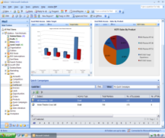




Concept: Integration Ports
AOS
Basic Inbound Port
(Service Group)
Custom application
Custom Service
(Running in IL)
Net.tcp://host1/port1/servicegroup1
Enhanced Inbound Port
Document Service
(Running in IL)
Transforms
Custom pipeline
file://port1/Request
Custom carved contract
Vendor
file://port1/Response
Transforms
Custom pipeline
© 2010 Microsoft Corporation. All rights reserved.
© 2010 Microsoft Corporation. All rights reserved.

Slide 15
Lab 14.1: Set Up Enhanced Inbound Port
Lab Scenario
You would like to set up an inbound port to create document handling attachments for various records in the system
Notes:
Step by Step
To set up an inbound port to enter AIF vendors, follow these steps:
Open System administration > Setup > Services and Application Integration Framework > Inbound ports.
Click New.
In the Port name field, type "DocHandling".
Click Service operations on the Service contract customizations FastTab.
Drag the service operations starting with "DocumentHandlingService.create" from Remaining service operations to Selected service operations.
Close the Select service operations form.
At the top of the screen click Activate.
When the process is finished, an infolog form will appear. Review the message and then click Close.
Go to http://AX2012-A:8101/DynamicsAx/Services/DocHandling to view the WSDL of the Inbound port you just activated.
Close the internet browser, and then close the Inbound ports form.

Slide 16
Adapters
Overview
Addresses
Procedure: Exchanging documents – File system adapter
Notes:
Integration ports in Microsoft Dynamics AX 2012 services and AIF use adapters so that Microsoft Dynamics AX can communicate by using a variety of transport protocols.
Microsoft Dynamics AX 2012 provides the following four adapters that represent predefined bindings:
HTTP adapter: Provides an HTTP or HTTPs transport
NetTCP adapter: Provides WS-* standards support over the Transmission Control Protocol (TCP) transport. This adapter corresponds to the WCF-NetTcp adapter in WCF
MSMQ adapter: Provides support for queuing by leveraging MSMQ as a transport. This adapter corresponds to the WCF-NetMSMQ adapter in WCF
File system adapter: Provides support for exchanging documents through file system paths. While not a WCF adapter itself, this adapter uses WCF to allow communication
Note: You can choose the appropriate adapter for your connection when you configure an enhanced integration port. For example, you can have a scenario where the chart of accounts is sent from Microsoft Dynamics AX to two external systems. One system could be configured to receive messages by checking a specific file system directory for files, by using the file system adapter, while the second system could be configured to use MSMQ to receive messages, by using the MSMQ adapter. In this scenario, both messages are first placed in the queue in Microsoft Dynamics AX.

Slide 17
Adapters Overview
In Microsoft Dynamics AX 2012 integration ports use adapters. These adapters enable Microsoft Dynamics AX to communicate by using various transport protocols.
HTTP Adapter - This adapter provides for synchronous message exchanges by using an HTTP or HTTPs transport
NetTCP Adapter - This adapter provides for synchronous exchange by using WS-* over TCP
MSMQ Adapter - This adapter provides support for queuing by using Message Queuing as a transport. Message Queuing is a type of asynchronous communication. This adapter corresponds to the WCF-NetMsmq binding in WCF
File System Adapter - This adapter provides support for the asynchronous exchange of documents through file system directories
Notes:
To start and stop processing in the queues, use the Microsoft Dynamics AX batch processing features. When a batch job starts, it retrieves messages from the queue. The batch job will send the first message to the first system by using the appropriate directory and send the second message to the appropriate MSMQ queue for the second system.
About Addresses
You can use an inbound or outbound integration port to associate Microsoft Dynamics AX services with an address. An address consists of a Uniform Resource Identifier (URI) that is associated with a particular adapter. A URI provides the location of the source or destination that the adapter can use, such as a file folder or an HTTP URL.
The following table provides information about adapters and the associated URI types that are available by default. You can add custom adapters, if required. The creation of custom adapters is beyond the scope of this course:
Note: Some features require the use of a specific adapter with a specific type of URI.

Slide 18
Address
An address consists of a Uniform Resource Identifier (URI) that is associated with a particular adapter
A URI provides the location of the source or destination that the adapter can use, for example a file folder path or an HTTP URL
Addresses depend on the type of adapter being used
Adapter Name | Adapter Type | URI Type
HTTP | Send and receive | URL
NetTCP | Send and receive | automatically provided by Microsoft Dynamics AX, based on the port name
MSMQ | Receive or send | based on the queue that you select
File System Adapter | Receive or send | file system path of the directory
Notes:
Note: The response message gets sent once the inbound request has completed and includes the key field values that were created from the inbound request.

Slide 19
Lab 14.2: Exchange Documents Using File System Adapter
Lab Scenario
Contoso works with a trading partner who needs to read sales orders in their system. You have to setup a file system adapter to read sales order request
Notes:
Scenario
Contoso works with a trading partner who needs to read sales orders in their system. Contoso will use AIF and the file system adapter to read a sales order request. This demonstrates how to perform an asynchronous document exchange using the file system adapter.
Step by Step
Create the file system directories. To enable the document exchange, you must create the following two folders.
A folder to contain the source document for the request. Name this folder “C:\AIFIn”. This is the folder from which AIF will get the original sales order that is written in a custom schema.
A folder to receive the AIF response. Name this folder “C:\AIFOut”.
Create and configure the integration port. To receive a new sales order and provide a response message, you will use an inbound integration port.
Open the Inbound ports form. Click System administration > Setup > Services and Application Integration Framework > Inbound ports.
Click New.
Name the new integration port “SalesOrderRead”.
Provide description of new integration port “Read a sales order using file adapter”
In the Adapter list in the Address group, select File system adapter.
In the URI list, click the arrow to browse to the folder that you created, named “AIFIn”.

Slide 20
Notes Continued
Notes:
Select the Response address check box and repeat steps 1 and 2. This time, in the URI list, provide the path to the folder that you created, named “AIFOut”.
The response message gets sent once the inbound request has completed and includes the key field values that were created from the inbound request.
If the user submitting the document is part of the Local Administrators group on the machine:
Click the Configure button next to Adapter
Check “Use default owner for Administrators group” and select your Microsoft Dynamics AX User (for this class select Admin)
Check “Use default owner for Network services account”
On the Service contract customizations FastTab, click Service operations.
In the Select service operations form, select SalesSalesOrderService.read in the Remaining service operations list. Click the left arrow to move the service operation to the Selected service operations list.
Close the form.
On the Service contract customizations FastTab, click the Customize documents checkbox and then click Data policies.
In the Document data policies form, select to Enable all fields.
Close the form.
In the Inbound ports form, click Activate to deploy the new integration port.
Close the form.
Send the request and view the response.
Save a copy of the “ReadSalesOrder.xml” you created to the “AIFIn” folder.
Configure and start the AIF batch services. For asynchronous document exchanges, such as the one demonstrated in this scenario, you must configure an AIF batch job. This batch job periodically executes business logic through integration ports that are configured to use asynchronous adapters. For this class and to save time, we will simulate the batch process by running the job we created in the AOT earlier
Open a New Development Workspace
Run the AOT job called “runAif”
It will take a few seconds to complete
Watch the folder that you named “AIFOut”. After a few minutes, a response file will be saved to this folder by AIF.
Open the response file to view the XML code. A valid XML response contains the number of the sales order that was created in the field named SalesId.

Slide 21
Notes Continued
Notes:
The response message contains an element titled <RequestMessageId>. This element contains the same GUID value that you provided for the <MessageId> element in the original request document. You can use this value to match responses to requests, a process called correlation.

Slide 22
Monitoring Services and AIF
The maintenance and management of document exchanges involves the following tasks:
Monitor traffic and view the document history as documents pass through the framework
Clear and review messages in the queues for adapter-based exchanges
View the exception logs when problems occur
Modify and resubmit messages that contain formatting errors
Stop and start the batch services when necessary

Slide 23
View the Document History
Information about messages and the document history are organized by the service operation for each port
Click System administration > Periodic > Services and Application Integration Framework > History
In the Display by field, you can filter the display by selecting either Message or Document
If you select Message, you see the following information about the message: the port, service operation, message ID, company accounts ID, and date and time that the message was created
If you select Document, you see both the information about the message, and the form name and entity key for the document
Notes:
Procedure: View the Document History
To view the general history for a document, follow these steps:
Click System administration > Periodic > Services and Application Integration Framework > History.
In the Display by field, you can filter the display by selecting either Message or Document.
When you filter by Message, the following information about the message is visible: the port, the service operation, the message ID, the company accounts ID, and the date and time of the message creation.
When you filter by Document, in addition to the items mentioned under Message, also visible are the form name and entity key for the document.
Click the General tab to view the message-set identifier.
Click the Details tab to view the following information:
The message direction (inbound or outbound).
The pipeline identification (if any).
User information for the port (the Microsoft Dynamics AX user associated with the port) and the submitting user. This is the user associated with the process that submitted the message (the Microsoft Dynamics AX user that submitted the message for the port, or a trusted intermediary).

Slide 24
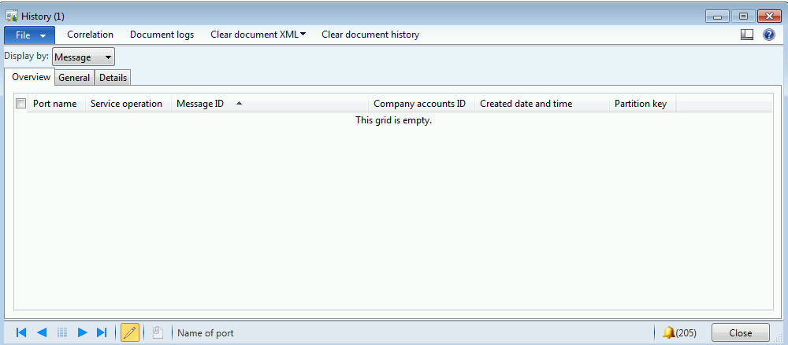
View the Document History (continued)
Notes:
For outbound documents sent in response to read requests, the Request message ID field shows the message ID for the original request.
Address details, which include the Adapter and the URI used for the exchange.

Slide 25
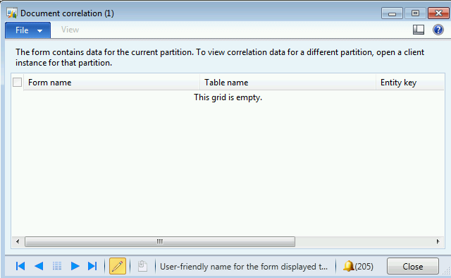
View the Data in a Document for a Message
Click System administration > Periodic > Services and Application Integration Framework > History
In the Display by field, select Message. Select a message, and then click Correlation
In the Document correlation form, view the form name, table name, and entity key for the database record that is contained in the selected message. Click View to display the data in the default form for the document
Notes:
Procedure: View the Data in a Document for a Message
To view the data in a document for a message, follow these steps:
Click System administration > Periodic > Services and Application Integration Framework > History.
In the Display by field, filter by Message.
Select a message and click Correlation.
On the Document correlation form, view the form name, table name, and entity key for the database record contained in the message you selected. You can also view a record for each of the numbered versions of the document and the related processing steps.
Click View to view the data displayed in the default form for that document.

Slide 26
Delete a Message
When you delete a message by using the History form, you delete that message from the AifMessageLog table
Click System administration > Periodic > Services and Application Integration Framework > History
In the Display by field, select Message
Press ALT+F9 to delete the record from the document
Notes:
Procedure: Delete a Message
When you delete a message by using the History form, you delete it from the AifMessageLog table.
Click System administration > Periodic > Services and Application Integration Framework > History.
In the Display by field, filter by Message.
Press ALT+F9 to delete the record from the document history.

Slide 27
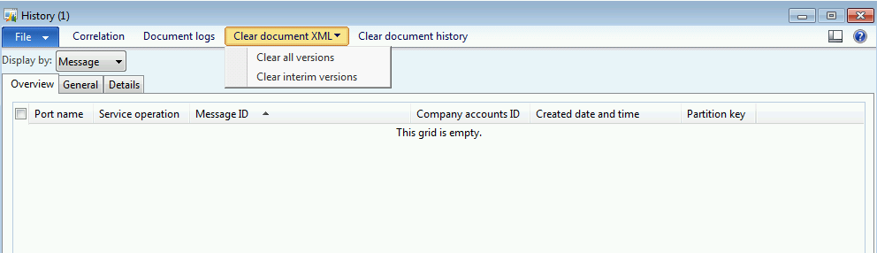
Delete the XML for a Document
Click System administration > Periodic > Services and Application Integration Framework > History
In the Display by field, select Document
Select a document, and then click Clear document XML
To clear all the versions of the XML document that exist in the system, click Clear all versions. To clear all intermediate versions of the XML document, click Clear interim versions
Notes:
Procedure: Delete the XML for a Document
To delete the XML for a document, follow these steps:
Click System administration > Periodic > Services and Application Integration Framework > History.
In the Display by field, filter by Document and select a document.
Click Clear document XML.
To clear all the XML document images in the system, click Clear all versions.
To clear all interim versions of the XML document, click Clear interim versions. For outbound documents, this clears all versions except the highest-numbered version. For inbound documents, this clears all versions except the first one.

Slide 28
View the Document Log
We can store copies of the XML code for documents that are exchanged with AIF and view them in the Document log form. When you configured the troubleshooting options for a port, you selected a logging mode. To use the document log, follow these steps
Click System administration > Periodic > Services and Application Integration Framework > History
In the Display by field, select Document. On the Overview tab, select a document, and then click Document logs
To view the XML code that is associated with one of the versions, select the record, and then click View XML
Notes:
Procedure: View the Document Log
You can store copies of the XML code for documents that are exchanged with AIF and view them in the Document log form. When you configured the troubleshooting options for a port, you selected a logging mode.
In the Document log form, you can view a record of the numbered versions of the document and the related processing steps, and the date and time for each log entry.
To use the document log, follow these steps.
Click System administration > Periodic > Services and Application Integration Framework > History.
In the Display by field, select Document.
On the Overview tab, select a document and click Document logs.
To view the XML associated with one of the versions, select the record and click View XML.

Slide 29
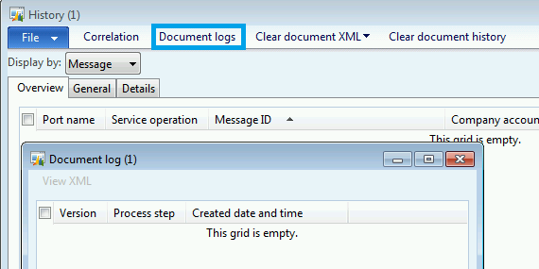
View the Document Log (continued)
Notes:
Procedure: View the Document Log
You can store copies of the XML code for documents that are exchanged with AIF and view them in the Document log form. When you configured the troubleshooting options for a port, you selected a logging mode.
In the Document log form, you can view a record of the numbered versions of the document and the related processing steps, and the date and time for each log entry.
To use the document log, follow these steps.
Click System administration > Periodic > Services and Application Integration Framework > History.
In the Display by field, select Document.
On the Overview tab, select a document and click Document logs.
To view the XML associated with one of the versions, select the record and click View XML.

Slide 30
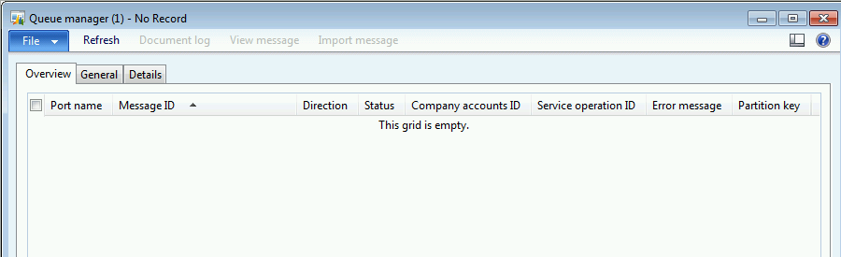
Queue Manager
The Queue manager form displays information about messages in the Application Integration Framework (AIF) queues. This information includes the status of each message.
Click System administration > Periodic > Services and Application Integration Framework > Queue manager
Notes:
Queue Manager
For adapter-based exchanges, you can use the Microsoft Dynamics AX batch functionality to start and stop the operation of the four services that move messages into and out of the document processing queues.
After documents are exchanged, you can monitor the activity of documents in the queues, and edit and resubmit documents that have errors by using the Queue manager form.
Click System administration > Periodic > Services and Application Integration Framework > Queue manager.
The Queue manager form displays information about messages in the AIF queues, including the following values for the status of the message:
Ready
In process (for inbound messages only)
Hold
Error
In transport process (for outbound messages only)
Malformed XML
If the status for a message is “Ready”, you can change it to “Hold” and vice versa.
Note: You can delete or edit a particular message if its status is set to Error or Hold.

Slide 31
Notes Continued
Notes:
Procedure: View Message Status and Details
To view the status and other details about a message, follow these steps.
Click System administration > Periodic > Services and Application Integration Framework > Queue manager.
On the Overview tab, view the port name, message ID, direction, status, company accounts ID, service operation, and any associated error message.
On the Details tab, view information about the submitting user, the Microsoft Dynamics AX user identification for the port, and the date and time the message is created.
Click Refresh to update the display.
Click Document log to view information about the document contained in the message, depending on the logging options set for the port.

Slide 32
Queue Manager (continued)
The following statuses are used:
Ready
In process – This status is used for inbound messages only
Hold
Error
In transport process – This status is used for outbound messages only
Malformed XML
If the status of a message is set to Ready, you can change the status to Hold. If the status is set to Hold, you can change it to Ready. If the status is set to Error or Hold, you can delete or modify the message
Notes:
Procedure: Delete a Message
If a message remains unprocessed in the AIF queues, you can delete it in the Queue manager form.
Click System administration > Periodic > Services and Application Integration Framework > Queue manager.
If the value in the Status field is Error, Malformed XML, or Hold, then you can delete the message.
Press ALT+F9 to delete the message.
Procedure: Edit and Resubmit a Message
Hold to Ready.
If a message enters the queue but cannot be processed because of an error, it might be possible to edit and resubmit the message. To resubmit a message, follow these steps.
If the message status is Error or Hold, click View message to view the message and then optionally write the message to an XML file after entering the file name and path.
Edit the file you just saved in any XML editor to correct the field or fields in error.
Click Import message to import the file.
To signal the queue to begin processing the message, change the status of the message from Error or

Slide 33
Exception
The exceptions log contains a record of all the errors that occur during document exchanges in Application Integration Framework (AIF). In the Exceptions form, you can view information about the module and subsystem where the error occurred, and a description of the error.
Click System administration > Periodic > Services and Application Integration Framework > Exceptions.
Click Exception help to see more information about the exception, if more information is available
Press ALT+F9 to delete the exception record from the system
Notes:
To view information about AIF error messages when they occur open the Exceptions form. (Click System administration > Periodic > Services and Application Integration Framework > Exceptions.).
The exceptions log contains a record of all the errors that occur during document exchanges in AIF.
The Exceptions form contains information about the module and the subsystem where the error occurred, a description of the error, when the error is logged, the user associated with the error, and the form or business logic where the error occurred.
Procedure: View and Clear the Exceptions Log
To view the exception log, follow these steps:
Click System administration > Periodic > Services and Application Integration Framework > Exceptions.
On the Overview tab, select an exception record.
Use the General tab to view additional details about the exception.
Click Exception help to view more information about the exception, if more information is available.
To clear the exception log, follow these steps:
Click System administration > Periodic > Services and Application Integration Framework > Exceptions.

Slide 34
Notes Continued
Notes:
On the Overview tab, select an exception record.
Press ALT+F9 to delete the exception record from the system.
Note: You can use the SHIFT and CTRL keys or the grid check boxes to select multiple records in the exception log grid.

Slide 35
Starting and Stopping the Batch Services
For adapter-based exchanges, you use the Microsoft Dynamics AX batch functionality to start and stop the operation of the following four AIF services:
AIFGatewayReceiveService
AIFInboundProcessingService
AIFOutboundProcessingService
AIFGatewaySendService
Notes:
For adapter-based exchanges, you use the Microsoft Dynamics AX batch functionality to start and stop the operation of the following four AIF services:
AIFGatewayReceiveService – This service communicates with the adapters, receives messages from their external source locations, and puts them into the gateway queue to wait for processing.
AIFInboundProcessingService – This service takes incoming messages from the gateway queue and then processes the documents according to the rules that are specified by the inbound port.
AIFOutboundProcessingService – This service processes an outbound document according to the rules that are specified by the integration port and then adds the envelope XML code to create a fully-formed AIF message. The service then places the message into the gateway queue to send.
AIFGatewaySendService – This service sends the messages to the correct external destinations.
These services move messages into and out of the document processing queues. You might need to start and stop these services to troubleshoot any issues or to change the batch job settings such as recurrence.

Slide 36
Migrating Configurations between Environments
Overview
Prerequisites
Exporting/importing the service metadata
Export/importing the integration port data
Notes:
Microsoft Dynamics AX 2012 uses integration ports to manage integration scenarios in the services and AIF. To move service configurations from test environments to production environments, you must meet specific prerequisites and complete the following tasks:
Export the service metadata from the source environment, which is the test environment. This metadata includes AOT code, service details, and so on
Export data about integration ports from the source environment. The data is exported as a .dat file
Import the exported metadata into the destination environment, which is the production environment
Import the integration port data into the destination environment
Prerequisites
Before you migrate from a test environment to a production environment, ensure that you meet the following prerequisites:
For file-based integrations, the account for the AOS must have read/write permissions for the file share. The file share must not be an administrative share, such as shares that contain a dollar sign ($).
The user who is importing the port configurations into the destination environment must have privileges as an AIF administrator.
Important: To import port configurations, the user must have the Maintain services & integrations privilege.

Slide 37
Migrating Configurations Overview
Microsoft Dynamics AX 2012 integration port configurations can be move between environments, such as from a test environment to a production environment, by using Microsoft Dynamics AX import/export
To move integration port configurations from a test environment to a production environment, you must complete the following tasks:
Make sure that the prerequisites have been met
Export the data about integration ports from the source environment. The data is exported as a .dat file
Import the data about integration ports into the destination environment
To export or import service metadata, you must use the command-line tool AXUtil.exe
Notes:
AxUtil exportstore –file:<file> -s:<DB server> -db:<DB name> -verbose

Slide 38
Migrating Configurations Prerequisites
Before you copy integration port configurations from a test environment to a production environment, make sure that the following prerequisites have been met:
For file-based integrations, the account for Application Object Server (AOS) must have read/write permissions for the directory that is used to import and export data
The user who imports the port configurations into the destination environment must belong to a role that has the Manage services and integrations privilege
All customizations must first be added to the source environment, and the application must compile without errors
All ports must be activated and tested. For ports that are based on NetTCP and HTTP, the Web Service Description Language (WSDL) files must be published
Notes:
Prerequisites
Before you migrate from a test environment to a production environment, ensure that you meet the following prerequisites:
For file-based integrations, the account for the AOS must have read/write permissions for the file share. The file share must not be an administrative share, such as shares that contain a dollar sign ($).
The user who is importing the port configurations into the destination environment must have privileges as an AIF administrator.
All customizations must first be added to the source environment, and the application must compile without errors.
All ports must be activated and tested. For ports that are based on NetTCP and HTTP, the WSDL must be published, and a client must be able to invoke the service through service calls. For ports that are based on file system adapters and MSMQ adapters, the corresponding scenario must be tested.
Tip: During export, you may receive the following message: "Table DirPartyCollection was not found." If you receive this message, add export criteria, described in Step 3, of the "Export the Integration Port Data" procedure, to export only new and customized ports.
Important: To import port configurations, the user must have the Maintain services & integrations privilege.
AxUtil importstore –file:<file> -s:<DB server> -db:<DB name> -verbose

Slide 39
Notes Continued
Notes:
Note: You can customize Microsoft Dynamics AX by adding a service group in the AOT. A service group is listed as a basic port in the Inbound ports form. If you added a service group in the source environment, and set the AutoDeploy property of the service group to "Yes," now the basic port is active in the destination environment.
Note: This process will need to be complete once for each file that was exported in the Procedure: Export the Integration Port Data.

Slide 40
Migrating Service Metadata and Integration Port Data
Scenario
Simon, the Systems Implementer has to move Service metadata and integration port data from test to production
Procedure
Export Metadata from source
Model or model store export – covered in previous chapter
Export Integration Port data from source
System administration > Common > Data export/import > Definition groups
Import Metadata to destination
Model or model store import – covered in previous chapter
Import Integration Port data to destination
System administration > Common > Data export/import > Import
Notes:
Procedure: Export the Service Metadata
In the source environment, you export the service metadata that you want to move into the destination environment.
Use the Export-AXModelStore or Export-AXModel PowerShell command as discussed in chapter 3 to export the necessary metadata.
Procedure: Export the Integration Port Data Create a new definition group for exports. Click System administration > Common > Data export/import > Definition groups.
Click New.
Enter a unique name for the group into the Definition group field.
Optionally enter a description.
Click the Options tab and clear all the check boxes.
Click the Include table groups tab and clear all the check boxes.
Click OK.
Select tables for the definition group by clicking Select tables.
Click Add, and then for inbound ports, select AifInboundPort in the Name of table field.
Select Include document references and Specify related tables check boxes.
Click the Select related tables button. On the Select related tables form, select the desired related tables to include and then click Close.

Slide 41
Notes Continued
Notes:
Optionally, add export criteria by selecting the Apply criteria check box, and then click Export criteria. Enter the desired filter criteria and then click OK.
Close the Select tables form.
Export the data to a local or network file share by clicking Export to on the Definition groups form. Select the file name and path, and then select the file type. Click OK to export the data to the file specified.
Close the Definition group form.
Repeat steps 1 through 4 using AifOutboundPort in the Name of table field in step 2.a instead of AifInboundPort.
Procedure: Import the Service Metadata
In the destination environment, you import the service metadata that you exported from the source environment.
Use the Import-AXModelStore or Install-AXModel PowerShell commands as discussed in chapter 3 to import the necessary metadata.
Procedure: Import the Integration Port Data
In the destination environment, use the following steps to import the file for the integration port data you exported from the source environment.
Open the Import options form. Click System administration > Common > Data export/import > Import.
If you exported only selected ports by using export criteria, select Update existing record on the Advanced tab. Otherwise, existing ports in the destination environment are deleted.
When you have finished importing the data you must deactivate the imported ports, register services, register basic ports, update the configuration details for each port (for example update URIs based on paths in the production environment), and then activate the ports.
Tip: During export, you may receive the following message: "Table DirPartyCollection was not found." If you receive this message, add export criteria, described in Step 3, of the "Export the Integration Port Data" procedure, to export only new and customized ports.
Note: You can customize Microsoft Dynamics AX by adding a service group in the AOT. A service group is listed as a basic port in the Inbound ports form. If you added a service group in the source environment, and set the AutoDeploy property of the service group to "Yes," now the basic port is active in the destination environment.
Note: This process will need to be complete once for each file that was exported in the Procedure: Export the Integration Port Data.
Important: If the production environment is part of a cluster, you must restart all AOS instances to guarantee that all configurations are updated.

Slide 42
Integration and Planning
Overview
Support for non-XML files
Messages and transforms in AIF
Plan for integration

Slide 43
Overview
Services are expanded to support additional integration scenarios. These changes include the following:
Support for non-XML file formats
Out-of-the-box integration "templates" for banking scenarios
Support for large messages import
10 MB limit removed.
Support for flexible error handling on large imports
Rollback, halt, and continue paradigms supported in error

Slide 44
Support for Non-XML Files
A transform pipeline is introduced to change the format of service requests and responses to fit the requirements of external systems
These transforms are configured at the port level and apply to all services on that port
The transforms types supported are Extensible Style sheet Language Transformations (XSLT), and .NET assemblies
We can consume and respond to XML formatted messages using a different schema, or to messages that are not XML such as Comma Separated Value (CSV) or fixed width files

Slide 45
Notes Continued

Slide 46
Messages and Transforms in AIF
In Microsoft Dynamics AX 2012 services and Application Integration Framework (AIF), a message corresponds to a Windows Communication Foundation (WCF) message
A message is a self-contained unit of data that can consist of several parts. These parts include a body and headers
Transforms provide an extensible framework that developers can use to apply XSLT or .NET-based transforms to messages. .Net-based transforms can convert messages to or from any proprietary format
Transforms are run for inbound exchanges before they are run for outbound exchanges. Transforms process the whole message. Headers are included in the processing

Slide 47
Integration Planning
In the planning phase, the implementation team must define high-level requirements and make decisions about the design of the integration
Integration design fits in two categories:
Data - Many decisions must be made about the data that is being exchanged and the associated business rules
Environment - Factors that affect these requirements include
Network configuration
Hardware and software configuration of the external system
Level of trust between Microsoft Dynamics AX and the external system

Slide 48
Integration Planning (continued)
Sample planning questions:
Data
What direction is the data flowing?
Are records in Microsoft Dynamics AX being created, updated, or deleted?
Environment
Is the exchange with an internal or external system?
Any restrictions on how data is exchanged?

Slide 49
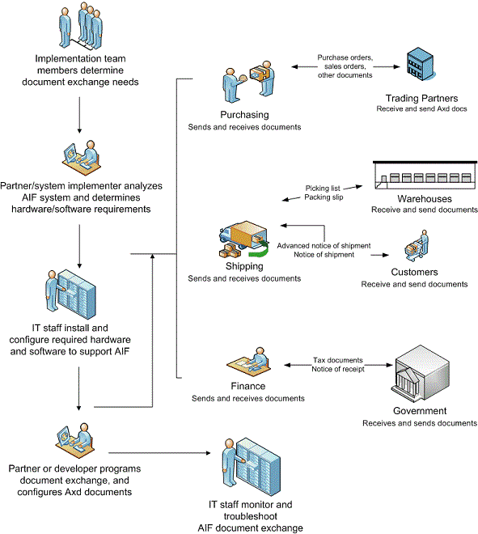
Overview of the Process of Integrating Microsoft Dynamics AX with Other Systems
Notes:
Whether you require integration with internal legacy systems or external trading partners, planning the integration process involves common key steps.
In a typical integration scenario, users who have business expertise first determine the document exchange needs. These are requirements from a business perspective. The business users work with the Implementation team to specify:
What data is to be exchanged.
Any business logic related to that data.
The external systems with which data is to be exchanged.
The conditions under which data is sent from or received by Microsoft Dynamics AX.
The partner or system implementer works with the customer and their IT staff to determine the hardware and software requirements for AIF. They analyze the existing environment and recommend any new hardware or software that must be installed.
The customer's IT staff installs and configures any required hardware and software to support AIF.
The partner or customer developer programs the document exchange. They can make customizations to the AIF documents or create new documents to meet the requirements of the business users. How AIF is configured depends in part on the network environment. Therefore, the developer may work with IT staff when implementing an integration scenario.
IT staff monitors the document exchanges and troubleshoot any errors that are generated.
Important: This planning information is a guideline for what you might need to consider when planning your data integration. For more information about your specific implementation, contact your partner.

Slide 50
Infrastructure and Deployment
Overview
Performance improvements
Data model
Windows communications foundation runtime
Services hosted on the AOS
Notes:
Important: The AOS clustering solution affects only the Remote Procedure Call (RPC) based connections and does not load balance Microsoft Dynamics AX services.

Slide 51
Overview
In Microsoft Dynamics AX 2012, improvements to the services framework result in significant changes in functionality, configuration, database schema, and document schemas (XSDs) to simplify the setup
Performance improvement
Data model changes
Windows Communication Foundation runtime
Services are hosted on AOS
IIS services are hosted without .NET Business connector

Slide 52
Improved Performance Over Previous Versions
Improvements in services and in the AIF include the following:
Scale out by using Network Load Balancing (NLB) for Microsoft Dynamics AX services
X++ services are complied into Common Intermediate Language (CIL)
Client applications can access services via the WCF runtime, without using .NET Business Connector
A deployment on an intranet does not require IIS, because by default, services are now hosted on AOS
Services can be hosted on IIS. However, all service requests, regardless of the origin, are routed to and processed on the AOS
Notes:
Note: Web services on IIS is an optional component. The Application AOS is the WCF service host for Microsoft Dynamics AX services. The AOS-hosted services are available to users and applications across the Intranet. To consume services over the Internet, you must host services on IIS. Skip this procedure if you do not need to expose the Microsoft Dynamics AX services over the Internet.

Slide 53
Improved Performance Over Previous Versions (continued)
The services framework uses connection pooling to reduce the overhead of creating and destroying a session on service calls
All the service references are placed in a single web services description language (WSDL) file. The single WSDL file lets developers reuse types when Microsoft Dynamics AX services are consumed

Slide 54
Data Model Changes
The document services framework supports the data model changes implemented in Microsoft Dynamics AX 2012. The document services framework handles the following scenarios to produce a usable data contract schema:
Replaces a surrogate foreign key (SFK) with the natural key for a specific table relationship. This means that the service contract has user-friendly, readable fields instead of obscure SFKs.
Handles all queries that contain the Global Address Book (GAB) views as one of their data sources.
Supports query data source tables that implement table inheritance.
Supports query data sources that contain tables with date effective fields.
Handles query data sources that contain tables with dimension columns. The framework supports serialization and deserialization of the dimension columns across the service boundary.
The wizards used to create and update document services support these data model changes.

Slide 55
WCF Runtime
Microsoft Dynamics AX 2012 provides expanded support for WCF beyond the basic HTTP and HTTPS bindings
The proprietary MSMQ and BizTalk Server adapters used in the previous releases of Microsoft Dynamics AX are no longer available
Instead, Microsoft Dynamics AX 2012 provides equivalent functionality through native WCF functionality
Custom adapters developed by customers and partners using the AIF adapter framework continue to be supported in this release

Slide 56
Services are Hosted on AOS
Services in Microsoft Dynamics AX 2012 are hosted on the AOS by default, but can also be hosted on IIS
If the AOS is used to host services no additional components need to be installed or configured to deploy services
To consume services over the Internet, you must host services on IIS.
Regardless of the origin of the service request, Internet or intranet, all the service requests are processed on the AOS

Slide 57
IIS Services are Hosted Without .NET BC
In the previous release of Microsoft Dynamics AX, services that were hosted on IIS required .NET Business Connector to communicate with AOS
In Microsoft Dynamics AX 2012, IIS-hosted services use the WCF routing service instead of .NET Business Connector
Notes:
Note: It is recommended to create a new website to install the Microsoft Dynamics AX web services for the ease of administration.
Note: You must restart IIS after Setup installs the web services. Select Restart IIS after the installation is complete to automatically restart IIS.

Slide 58
Security
WCF is responsible for authenticating the user
Each service operation causes a Microsoft Dynamics AX logon and logoff
By default, all external WCF service calls are made in the context of the Microsoft Dynamics AX identity of the caller
Notes:
Microsoft Dynamics AX services rely on WCF for security. You can change the WCF configuration to make necessary security settings that are required by Microsoft Dynamics AX services. WCF is responsible for authenticating the user.
A service operation performs a specific action on the document such as read, update, or delete. All service operations are performed in the context of a valid Microsoft Dynamics AX user.
When the AOS receives a service call, the services framework (AifMessageInspector) retrieves the Windows identity by using the ServiceSecurityContext class. This Windows identity is used to initialize a valid Microsoft Dynamics AX session. This Microsoft Dynamics AX session is used for all X++ operations and is released when the call is completed.
Each service operation causes a Microsoft Dynamics AX logon and logoff. Microsoft Dynamics AX uses session pooling to reduce the overhead of creating and destroying a session on every call.
By default, all external WCF service calls are made in the context of the Microsoft Dynamics AX identity of the caller. WCF allows for client credentials to be specified in WCF configuration or in the code. Configuration based credentials (such as certificates) can be specified in the WCF client configuration for the service.
Some of the client credential values cannot be set using the WCF configuration file such as the user name and password or the Windows user name and password. Such credential values must be specified in the code.

Slide 59
Activity: Test Your Knowledge
The class will complete this section

Slide 60
Chapter Review
Which AX system services are included with Microsoft Dynamics AX 2012? (Select all that apply)
( ) Metadata service
( ) Query service
( ) AOS service
( ) AOT service
What applications can host Microsoft Dynamics AX 2012 Services? (Select all that apply)
( ) Application Object Server (AOS)
( ) Internet Information Services (IIS)
( ) Apache
( ) Microsoft Dynamics AX 2012 Client

Slide 61
Chapter Review
What are service groups used for?
You want Microsoft Dynamics AX to consume data from a flat file provided by another system. What kind of Integration port would Simon need to create?
( ) Inbound-Basic
( ) Inbound-Enhanced
( ) Outbound-Basic
( ) Outbound-Enhanced

Slide 62
Chapter Review
What transform types does the Microsoft Dynamics AX 2012 services transformation pipeline support? (Select all that apply)
( ) Extensible Stylesheet Language Transformations (XSLT)
( ) .NET assemblies
( ) Comma separated
( ) Flat file
What changes in services in Microsoft Dynamics AX 2012 improve performance? (Select all that apply)
( ) Network Load Balancing (NLB) for Microsoft Dynamics AX services
( ) X++ services have been compiled into Common Intermediate Language (CIL)
( ) Support for non-XML files
( ) The services framework uses connection pooling to reduce the overhead of creating and destroying a session on service calls

Slide 63
Chapter Review (Answers)
Which AX system services are included with Microsoft Dynamics AX 2012? (Select all that apply)
(x) Metadata service
(x) Query service
( ) AOS service
( ) AOT service
What applications can host Microsoft Dynamics AX 2012 Services? (Select all that apply)
(x) Application Object Server (AOS)
(x) Internet Information Services (IIS)
( ) Apache
( ) Microsoft Dynamics AX 2012 Client

Slide 64
Chapter Review (Answers)
What are service groups used for?
To manage and deploy a group of services together
You want Microsoft Dynamics AX to consume data from a flat file provided by another system. What kind of Integration port would Simon need to create?
( ) Inbound-Basic
(x) Inbound-Enhanced
( ) Outbound-Basic
( ) Outbound-Enhanced

Slide 65
Chapter Review (Answers)
What transform types does the Microsoft Dynamics AX 2012 services transformation pipeline support? (Select all that apply)
(x) Extensible Stylesheet Language Transformations (XSLT)
(x) .NET assemblies
( ) Comma separated
( ) Flat file
What changes in services in Microsoft Dynamics AX 2012 improve performance? (Select all that apply)
(x) Network Load Balancing (NLB) for Microsoft Dynamics AX services
(x) X++ services have been compiled into Common Intermediate Language (CIL)
( ) Support for non-XML files
(x) The services framework uses connection pooling to reduce the overhead of creating and destroying a session on service calls

Slide 66
Chapter Summary
In this chapter we discussed the following:
How documents are exchanged with services and AIF
How to set up and administer services
Integration features
Tools for troubleshooting and monitoring services
Security

